Slide 1

School District Project
Abhay Kumar Singh, Mukund Srinath Heragu, Harshit Narang, Rizu Jain, Shubham Sanghavi, Sukanya Sravasti

Slide 2
Introduction
Educational Leadership Research Center (ELRC) at TAMU wants to develop a Machine Learning prediction model to predict if a school is at risk of failure in Texas’s school testing system
Currently, schools determine this process manually using past student scores and different variables, which is a very time-consuming process
We implemented an ML model to predict whether a school is at risk of failure using individual student data as a proof of concept for the ELRC

Slide 3
Background on Texas Education Agency STAAR Test and Accountability Rating
The State of Texas Assessments of Academic Readiness (STAAR) program was implemented in spring 2012 by the Texas Education Agency (TEA). It includes annual assessment tests for different subjects. Examples: Reading, Mathematics, Writing.
TEA provides annual accountability ratings to its public schools. The ratings assess student test performance, school progress and whether schools are closing the gaps among various student groups.
The idea is to identify using AI if the schools are at risk of failing in the state accountability ratings

Slide 4
How to predict the school ratings?
Schools have started taking practice tests of students, once in Fall and another in Spring. These tests are STAAR exam papers from previous years.
They help the schools in identifying how the students are doing and to estimate their scores in the final assessment.
The results of these mock tests are analyzed by a team of experts. That team first estimates how individual student would do in the final STAAR based on their performance in the mock tests
Then they will compile all the results for all the students to estimate what certificate the school will be getting.

Slide 5
Importance of predicting performance
By getting the predictions before the actual exams, the schools could identify which students are at a risk of failing.
This would help them know which group of students should be focused on to get the best increase in score.
Thus helping the school get all the insights they require for employing their resources and targeting the right group of students to maximize their certificate scores.

Slide 6
Scope for this Semester
The plan for this semester is to develop a Proof of Concept
Customer wants to know if Machine Learning can make predictions for students
Also, comparison of results with an human expert is to be done
This will be done on a single school’s data for Grade 3, Grade 4 and Grade 5.
The focus is less on the approach and more on the outcome as this will help the customer determine if this is worth pursuing.

Slide 7
Difference from other projects
This project involves predictions using ML and hence was different from typical SE projects.
Instead of the development pipeline, we had a Data Science pipeline where we did the tasks of Data gathering, Data cleaning, Data Processing, ML modelling and visualizations.
Besides this, the predictions were than used to develop the certification which had to be implemented.
As the customer was looking for a PoC, we have developed this project as that and hence we did not involve much unit testing.

Slide 8
Pipeline

Slide 9
Data Preparation
The data for each grade was received in a different form.
We had to write code to standardize the files that we will be inputting to the ML code.
For that, we joined the available data for all the students based on their student ids.
Apart from this, column naming also had to be managed in code in order to make sure that everything is standardize.
After this step, all the files for all the grades followed the same standard.
See ‘Data Preparation.ipynb’. Files stored in ‘prepared’ folders.

Slide 10
Data Processing
In this step we prepared the grade files for the Machine Learning model.
This involved mainly handling missing values, dropping values that were not needed and one hot encoding the vectors.
The only thing that we used for our predictions is the percent score as that remains constant across the exams.
Also, for the missing scores, if a student is missing one of the three required scores namely previous year’s score, fall mock test score and spring mock test score, we impute it with the mean of other 2 exams.

Slide 11
Data Processing
For grade 3, we do not have the previous year’s score.
If a student is missing both the mock test, we drop him.
If a student is missing one test score because of missing the exams or data errors, we would take the average of all the students within +- 5% of the student’s score in the mock whose score is available as the student’s score on the other exam.
Finally, after imputing the missing values, we would one hot encode the categorical features for ML models to use.
Files stored in ‘processed’ folders.

Slide 12
Machine Learning Model for Prediction
Individual-level student data for Carmichael school was pre-processed to get the necessary features for implementing the ML model
First, a Linear Regression model was trained on the data
Then, we trained a random forest classifier using grid search for hyper-parameter tuning.
Features for predicting student scores were the following: previous year STARR test score, past two years STARR mock tests, Ethnicity, Socioeconomic Status, Enrollment Duration, English proficiency
Files stored in predictions’ folders.

Slide 13
Prediction Processing
Once percent scores are received for each student, we convert them to raw scores using the total marks that the exam was for.
The TEA website hosts the conversion table for converting raw scores to scaled scores. It also shows at which level the student is like ‘Approaches’, ‘Meets’ or ‘Masters’ for that grade level.
These values are used to identify students into different categories.
These categories are necessary for calculating the consolidated school certificate.
Files stored in ‘processed predictions’ folders.

Slide 14
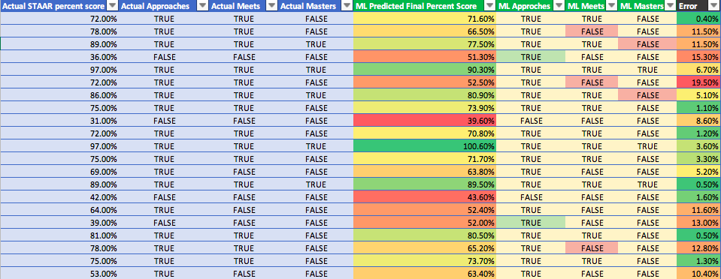
Results of ML Prediction
Example Grade 5 Math: accuracy was 80%

Slide 15
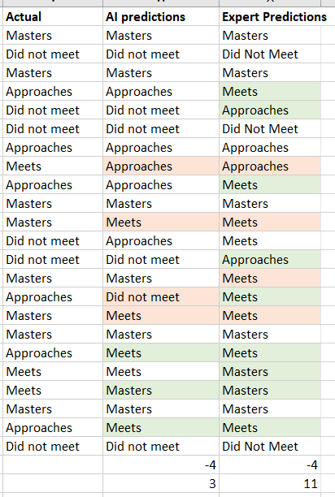
Comparison with the expert predictions
As part of the POC, customer wanted to compare the results that the ML model predicted with the predictions of an domain expert.
For this, we used the Grade 4 math and reading.
Shown in the image are the category predictions. First column shows the actual category that the student ended up in.
Second columns shows the predictions of our ML model and the third column shows the expert predictions.
Highlighted cells are incorrectly classified cells and the color shows if the prediction was an overestimate (green) or an underestimate(red) of the student’s actual score.

Slide 16
Comparison with the expert predictions
The comparison shows promising results as the ML performs better than the expert.
However, there are a couple of caveats here.
In reality, expert uses lot many parameters than the ones that they were allowed to use and hence their overall predictions would be much better than the ML algorithm.
Also, the ML used the students from the same batch. However, in reality data will be available for the previous batch.
There will be nothing that the model can learn about the final exam in the real world scenario.
In our PoC, it did have scores of other students for that.
The prior experiment could not be performed because of unavailability of the data.

Slide 17
School Report for Predicting Risk of Failure
Based on the ML predicted student scores, we generated a school report using the accountability classification Texas Education Agency uses
The school report had multiple domains that needed to be calculated from the predictions.
Each of these had complex rules to compute which are available on the TEA website.
We had to understand the logic behind them and implement it for the predictions that we had generated.

Slide 18
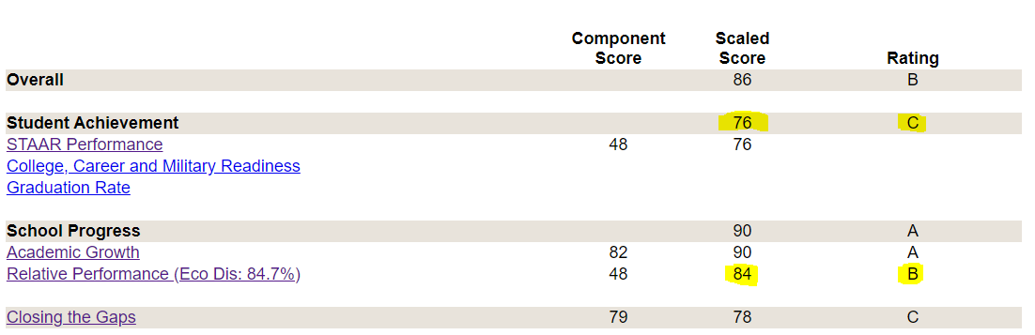
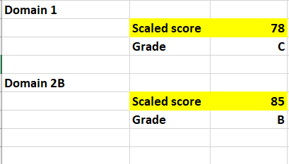
School certificate Domain 1 and 2B
ML predictions v/s Actual

Slide 19
School certificate Domain 1 and 2B
For these 2 domains the predictions from AI were very close to the actual predictions.
We believe this is because the AI’s underestimates and overestimates cancel each other out and hence the overall school score is very close to the actual score.
Domain 2A scores correspond to the growth of students over previous performance. We did not get to that in this semester.

Slide 20
School certificate Domain 3
Domain 3 involved evaluation of the performance of individual category of students on the test.
We implemented the code to calculate the Domain 3 scores given the individual student scores and their categories.
The code is submitted as a jupyter notebook.

Slide 21
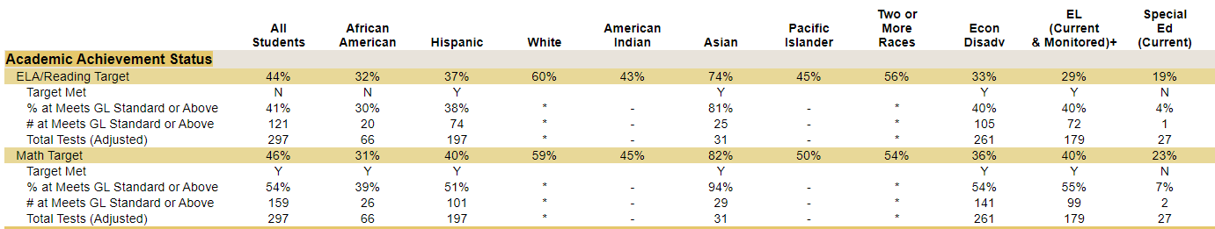
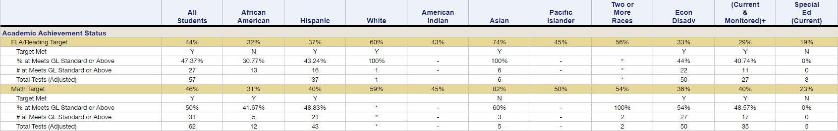
Domain 3: Actual v/s Predicted
* Only part of the certificate shown.

Slide 22
Achievements
Comprehend the problem
Develop an MVP
Take care of the data inconsistencies
Weekly meetings with the customer for presenting the results and in-depth discussions

Slide 23
Conclusion and Next Steps
As we have data with more student features and more tests, we would be able to train the model further, and test the model on a different sample of students who take a different year STARR test.
This semester we focused on implementing the ML model as a Proof of Concept for the customer.
Next steps would be to incorporate the model and the user interface within a Model-View-Controller(MVC) framework, so that school personnel can access the website, upload student data, get ML predictions and school report.

Slide 24
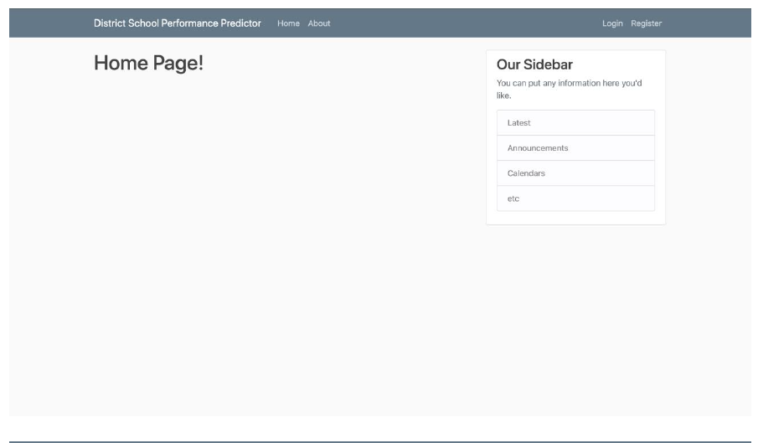
Website
As part of the future development, a website template has been created which has a functional login and the required pages for this application. This will help the next team in integrating the ML model.

